Slide 1

HR Analytics Overview
A comprehensive analysis of our 22,214-person workforce reveals opportunities for strategic growth and enhanced diversity across locations, departments, and demographics.

Slide 2
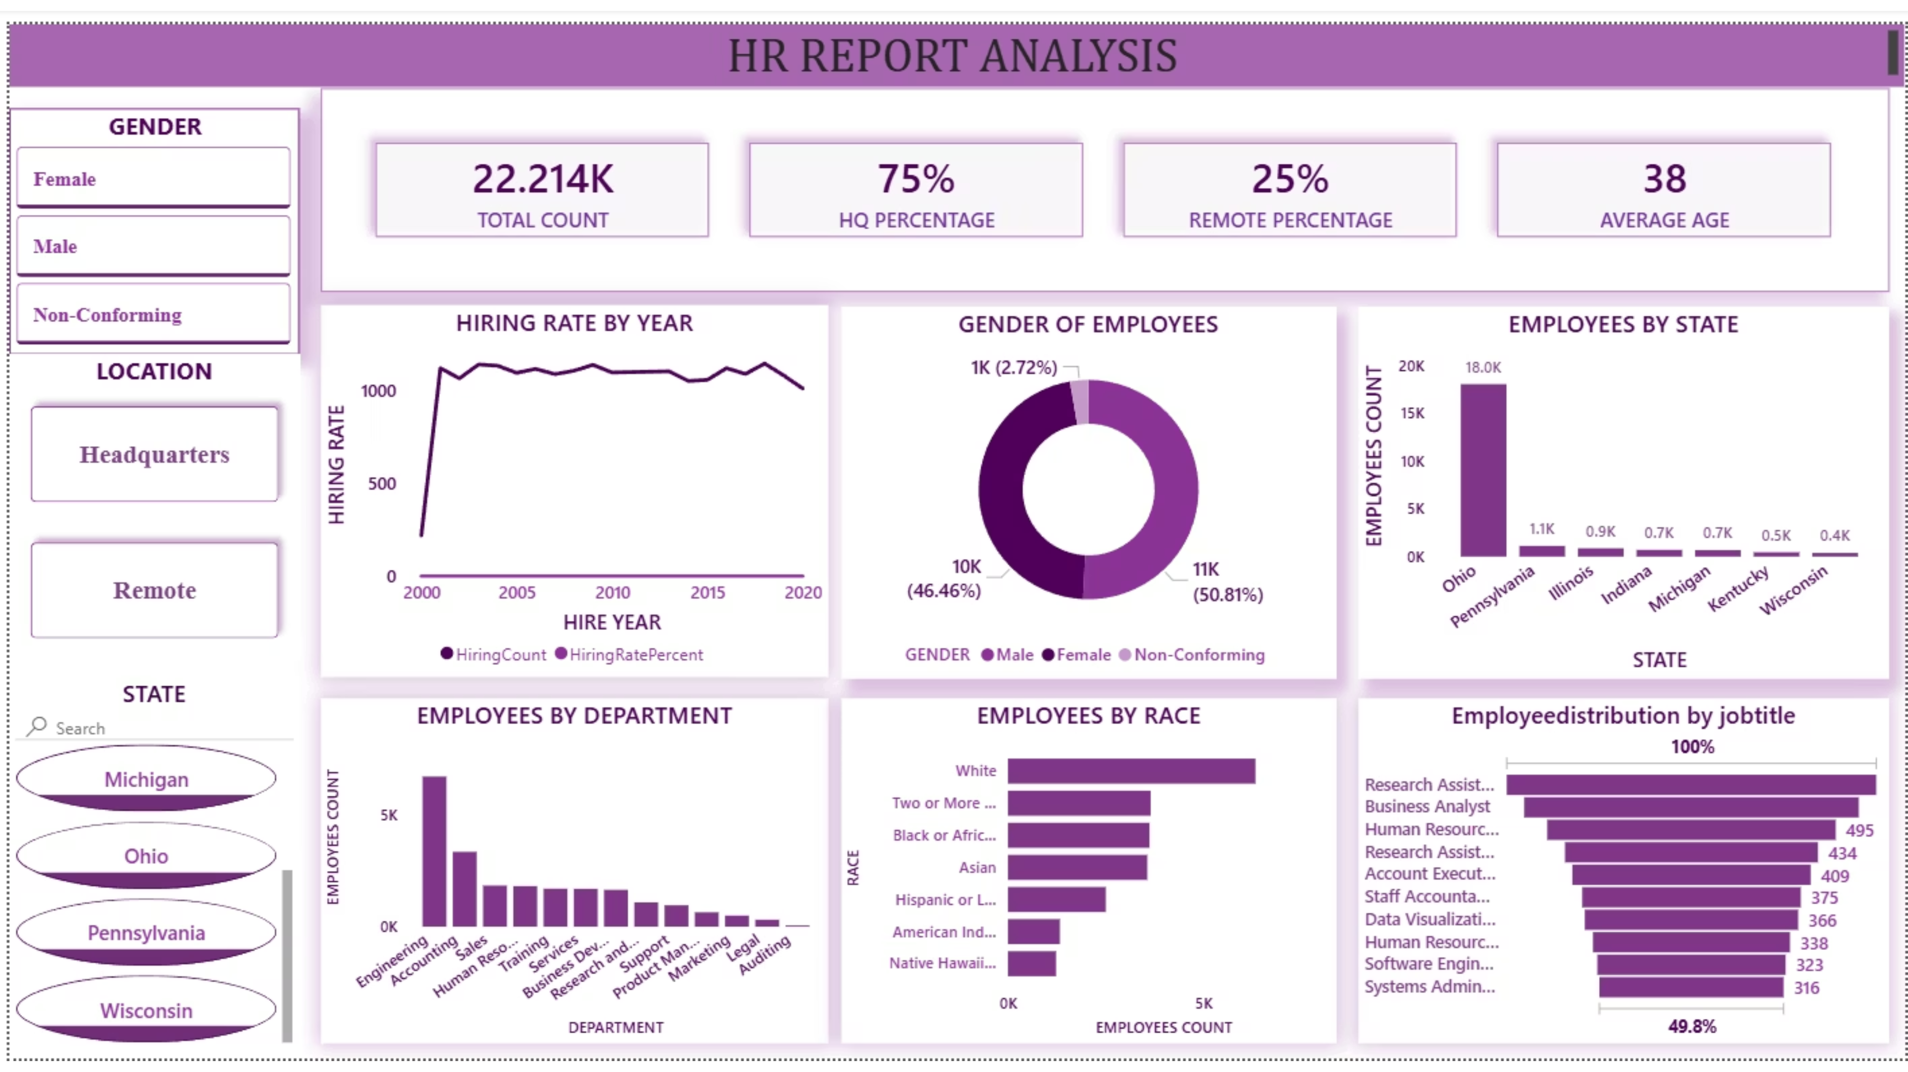
Notes:
This slide is a blank image card, so there is no specific content to cover. However, this could be a good opportunity to transition to the next topic or section of the presentation. I might suggest using this slide as a pause or break for the audience to reflect on the previous information. You could also use this as a chance to engage the audience by posing a question or inviting discussion. Ultimately, this slide provides flexibility to steer the presentation in the direction you feel is most appropriate.

Slide 3


Top-Level Metrics
22,214
75%
25%
38
Total Employees
At Headquarters
Remote Workers
Average Age
Current workforce size
Centralized operations
Flexible work adoption
Years of employee age
Recommendation: Introduce flexible work policies to attract younger talent while retaining experienced staff.

Slide 4
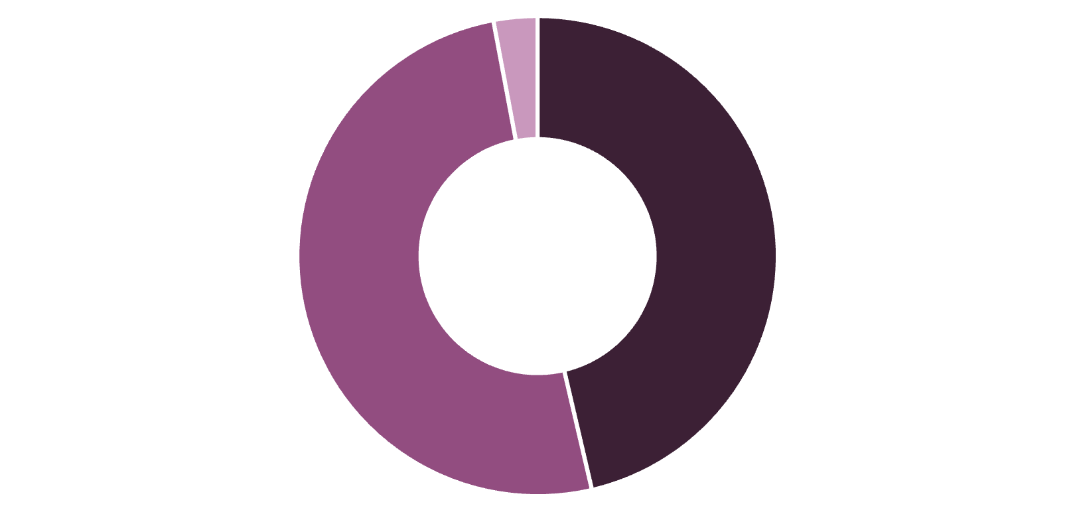

Demographics & Diversity
Gender Distribution
Race Distribution
White: 6328 employees
Two or More: 3,648
Black/African American: 3,619
Asian: 3,562
Hispanic/Latino: 2501
Others represented
Female
Male
Non-Conforming
Recommendation: Monitor pay equity and promotion rates across gender and race to ensure fairness.

Slide 5





Department & Job Title Focus
Engineering Leads
12 Core Departments
~5,000 employees in Engineering, our largest department
Accounting, Sales, HR, Training, Business Development, Services, R&D, Support, Product Management, Marketing, Legal, Auditing
Top Roles
Research Assistant (highest), Business Analyst, Software Engineer, Systems Administrator, Staff Accountant
Entry-Level
Research Assistants
Mid-Tier
Analysts
Senior
Engineers
Recommendations: Create career progression pathways for entry-level roles. Balance workforce by strengthening customer-facing roles (Sales, Support) to match product growth.

Slide 6
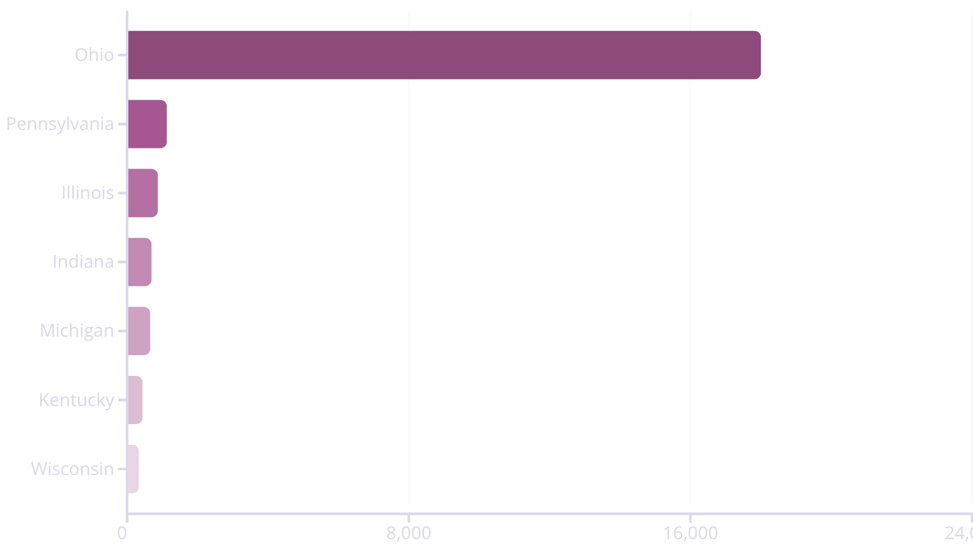

Geographic Spread & Hiring Trends
Location Distribution
Hiring Patterns
Hiring rate from 2000–2020 shows variable recruitment intensity with peaks and troughs aligned to business growth and economic conditions.
Key Insight: Ohio dominates with 18,000 employees, creating significant location risk.
Recommendations: Reduce location risk by expanding hiring in secondary hubs and remote roles. Conduct workforce forecasting to align hiring with market demand. Track attrition alongside hiring to measure net growth.

Slide 7






Key Observations & Strategic Priorities
Geographic Concentration
Tech-Driven Model
Highly centralized in Ohio, indicating operational dependency on one region—diversification needed.
Engineering-heavy workforce suggests a product or tech-driven business model with strong technical capabilities.
Gender Balance
Hybrid Work Model
Gender diversity is balanced with a small but visible non-conforming group—continue monitoring equity.
Remote work adoption at 25% hints at a hybrid model, possibly role-dependent—opportunity to expand flexibility.
Racial Diversity
Career Pathways
Racial diversity is present but skewed toward White and multiracial categories—opportunity for inclusive hiring initiatives.
Strong entry-level and mid-tier roles present—career progression pathways should be monitored and enhanced.

